Slide 1

How to get the most from Azure SQL Database & Managed Instance
José Manuel Jurado Diaz – Microsoft CSS
Thamires Lemes – Microsoft CSS

Slide 2





Jose Manuel Jurado Diaz
CIO of Contoso Co., his main concern is to pay less and achieve more = Benefit
@contoso_cio
http://www.linkedin.com/in/contoso/
jmjurado@contoso.com
Thamires Lemes
DBA, Consultant, Developer… working in Contoso, Co.
Always he needs to find the balance suggested by CIO:
Less Cost+(Achieve More+better HA)=Easy life
@contoso_dba
http://www.linkedin.com/in/contoso
Thamires.lemes@contoso.com

Slide 3

CIO Ask: What is the solution that you suggest?
I would like to reduce the cost of my Azure SQL Database but still keeping the same performance.
Read Scale-Out
Scalability
Serverless

Slide 4
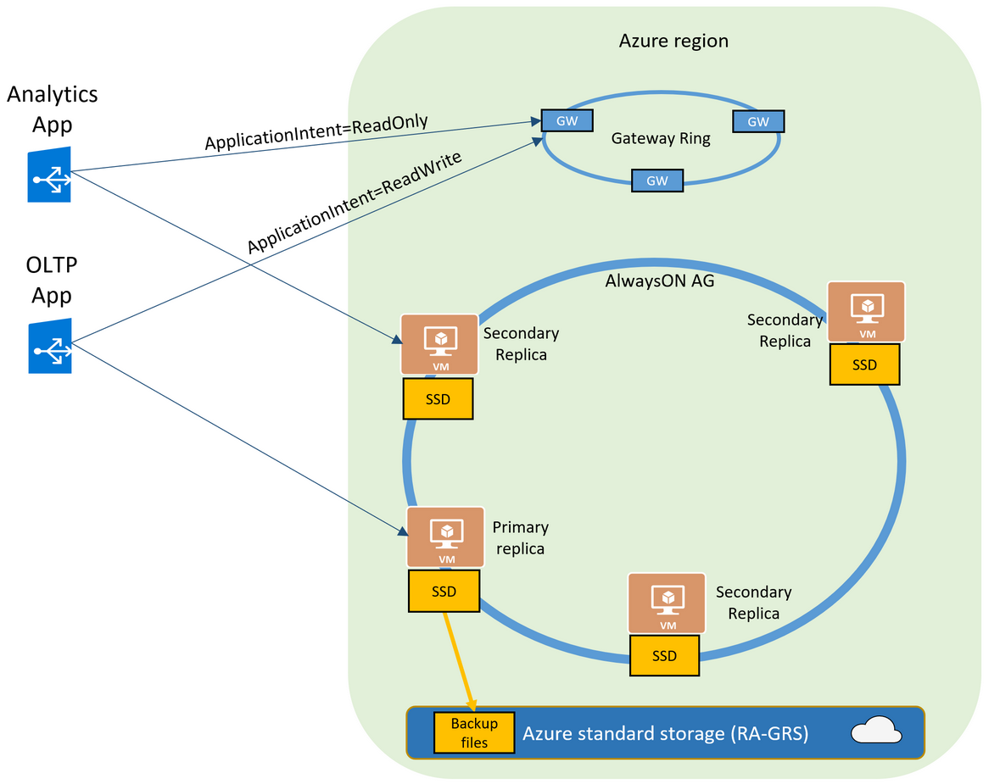
Read Scale-out
Premium / Business Critical / Hyperscale
Same compute size as primary at no extra cost
Enabled by default
(Disable use Portal, Powershell or Rest API)
SELECT DATABASEPROPERTYEX(DB_NAME(), 'Updateability’)
Return READ_ONLY

Slide 5
Read Scale-out
Query Data Store, Extended Events (Primary), SQL Profiler and Audit features are not supported
Supported DMVs
sys.dm_exec_sql_text sys.dm_exec_query_plan
sys.dm_exec_query_stats
sys.dm_db_resource_stats

Slide 6

Easy Scalable
Basic
General Purpose 1 vCore

Slide 7
Easy Scalable
Fast
P15
Hardware Generation
Scale out: Sharding
Hyperscale
Business Critical 80 vCore
Provisioned \ Serverless

Slide 8
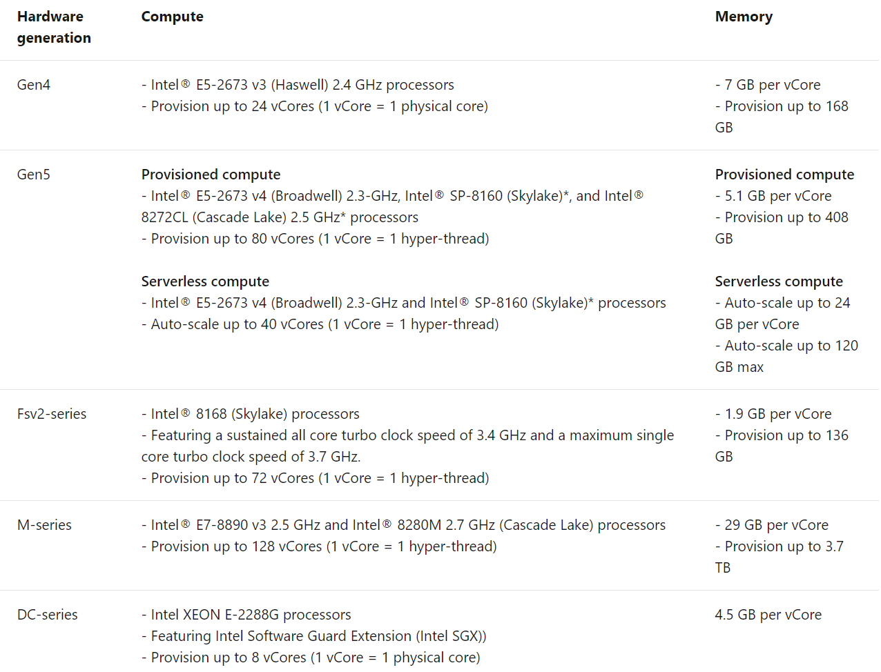
Easy Scalable
https://docs.microsoft.com/en-us/azure/sql-database/sql-database-service-tiers-vcore?tabs=azure-portal#hardware-generations

Slide 9
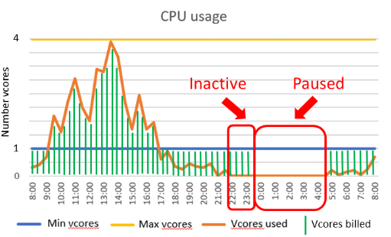
Serverless

Slide 10
Serverless
 | Serverless | Provisioned
Usage pattern | Intermittent Performance unpredictability Unknown resources | Multiple intermittent BDs Known and predictable workload
Performance management | Low | Medium
Performance | Automatic | Manual
Response time | Slow when inactive After some resource increments | Immediate
Charge | Second | Hour
Memory | More frequently claimed | As SQL Server on-premise

Slide 11

Serverless
Demo

Slide 12
CIO Ask: What is the solution that you suggest?
You know that we have 15.000+ customers that are using the same database, when I reviewed the invoice we are paying a lot of money for the database in Business Critical with 40 vCores, also, the database and backups sizes are quite large.
I received complains from the marketing people that every time they want to use the data for marketing campaings they need to remove a lot of tables and data from other customers.
Sharding

Slide 13
Sharding
Single-tenant vs Multi-tenant
Client 1
Client 2
Client 3
…
Client N
Client 1 Client 6 Client 21
Client 3 Client 12

Slide 14
Sharding
Single-tenant vs Multi-tenant
Client 1 Client 6 Client 21
Client 2
Client 3 Client 12
…
Client N

Slide 15
Sharding
Elastic Database split-merge tool
Client 1 Client 6
Client 2
Client 3 Client 12
…
Client N
Client 21
https://www.nuget.org/packages/Microsoft.Azure.SqlDatabase.ElasticScale.Service.SplitMerge/

Slide 16

Sharding
Client App build with client library
Shard Map Manager
Client 1
Client 2
Client 3
…
Client N
https://docs.microsoft.com/en-us/azure/sql-database/sql-database-elastic-database-client-library

Slide 17
CIO Ask: What is the solution that you suggest?
We are reaching the limit of our database (8TB) and I would like to know the solutions without needing to compress the data and compromise performance.
HyperScale

Slide 18

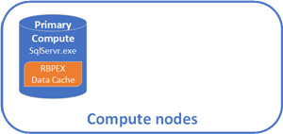
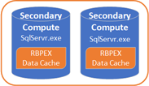
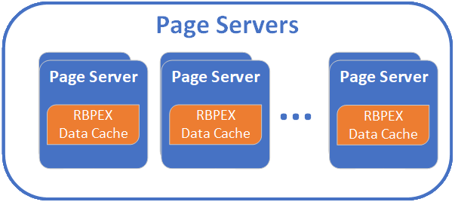
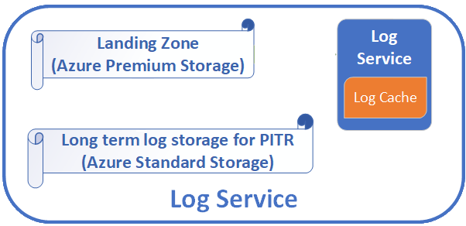
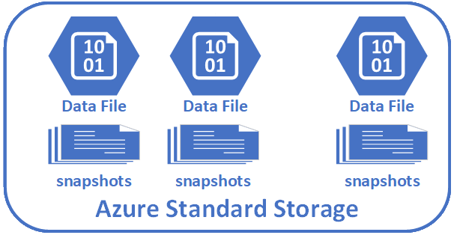
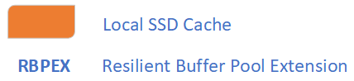
Hyperscale

Slide 19
Hyperscale
Demo

Slide 20
CIO Ask: What is the solution that you suggest?
I have some concerns about our High Availability. Also, yesterday, when I needed to report to our managers the great things that we are doing thanks to me, the reports tooks hours and I have to say that your DBA team is not working well and we need to change them.
Zone Redudant
Active Geo-Replication
Failover Group

Slide 21
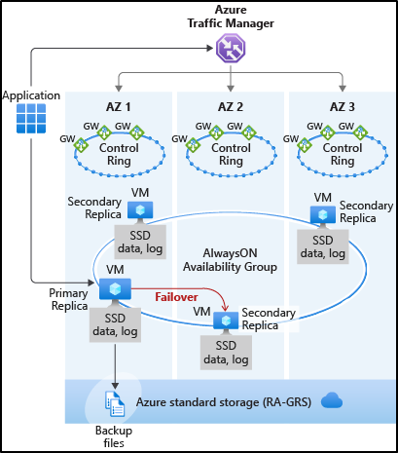
Zone redundant (Premium \ Business Critical)

Slide 22
Zone redundant
Premium or Business Critical (No extra cost)
General Purpose (extra cost) - Preview
More resilient without any change to application logic
Test your workload (latency) for Premium\Business Critical
Change an existing database and revert
Not available on all Azure Regions (Availability Zones)

Slide 23
Active Geo-Replication
Available on all Service tiers and Regions
Asynchronous replication
Up to 4 Readable Secondary replicas
To any region
Create secondary replica from another secondary (chaining)
Manual failover (Portal, Powershell, REST API or T-Sql)

Slide 24
Active Geo-Replication
Secondary
Secondary
Secondary
Primary
Secondary / Primary
Secondary
Secondary
Secondary

Slide 25
Fail-over Groups
Abstraction of Active Geo-Replication
One or many Fail-over Groups
Each Group can contain several DBs (recovered as a unit)
Automated and transparent fail-over
Fail-over policy
Grace period
Only one secondary replica in a different region

Slide 26
Fail-over Groups
End Points
Read-Write
<fail-over group name>.database.windows.net
Read-Only
<fail-over group name>.secondary.database.windows.net

Slide 27
CIO Ask: What is the solution that you suggest?
Our marketing team mentioned that they spent 1 hour to have all the information ready to make an important decision and I know that this is because 10.000.000 transactions per hour is not the problem.
You know that I’m a very skilled DBA and I saw that we are not using all the resources all the time and the maintenance window is taking hours.
Automatic Tuning

Slide 28
Automatic tuning
Learn from all databases on Azure
Very low impact on your workload
Automatic, manual or disabled
Configured at server or database level
Create index
Drop index
Force last good plan

Slide 29
CIO Ask: What is the solution that you suggest?
Our Security department reported that we have many ports open and all of them are public.
Could you please explain to me why that is?
Private Link

Slide 30

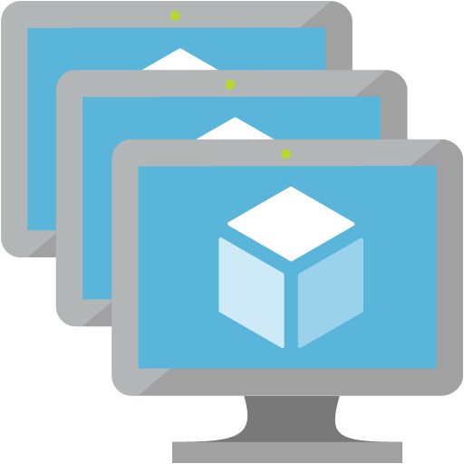


Private Link
App A (you)
SQL
Provides fixed private IP address for inbound connections
Works across regions, subscriptions and tenants
10.0.1.99
10.0.1.0/24

Slide 31
CIO Ask: What is the solution that you suggest?
It is very cool that you planned moving the data to Azure SQL Managed Instance, but, the cost is somewhat different from what we used to have with my fancy system.
Could you please explain to me before I fire you what was the reason of this test without asking me?
Why Managed Instance?

Slide 32


Which Azure SQL offering is right for you?
Migration, App Modernization, App Innovation
Control
Capabilities
Customer Managed
Full control and capabilities of SQL Server instance
OS level access
SQL Server versions 2008 - 2019
Patching/Upgrades
App or other services colocation
Yes
SQL Server on Azure VMs
?
No
Microsoft Managed
Fully managed SQL Server engine as a service
Native restore and log shipping
Cross-DB transactions and Linked Server
Service Broker and Event Notifications
SQL Agent and Transactional Replication
.NET CLR integration and ML Services
Yes
Azure SQL Managed Instance
No
Fully managed SQL database as a service
A database scoped programming model
Yes
Azure SQL Database

Slide 33



Supporting RDBMS PaaS: Azure SQL Database, Managed Instance, MySQL/MariaDB and PostgreSQL.
9 Years @ Microsoft
Supported SQL Server Core, Analysis Services and SQL Server On Azure VMs
Working with DevOps (ARM), startups companies, Developers, DBA, DBM, CIO, CFO, etc.
Jose Manuel Jurado
Escalation Engineer
Microsoft
/josemanueljuradodiaz
Speaker @SQL Saturday, TechReady, SQL Nexus, SQLBits, Microsoft Summit, Azure Global BootCamp, SQLKofenrenz, SQLDay.
Worked previously as DBA, Developer, IT Manager and other jobs for more than 25 years which I don’t even remember anymore. Microsoft Certified Trainer and other certifications.
@jmJuradoDiaz
José Manuel Jurado Díaz
Jmjurado@Microsoft.com

Slide 34
Supporting RDBMS PaaS: Azure SQL Database and Managed Instance
1 Year @ Microsoft
Worked previously as a DBA
11 Years
Thamires Lemes
Support Engineer
Microsoft
/thamireslemes
Thamires Lemes
thlemes@microsoft.com

Slide 35

Questions
Blog: Azure SQL Database Support​
https://bit.ly/2T9sj1a
Youtube Channel: Azure Support Academy
https://bit.ly/35gpd0D

